Slide 1
Observability for your SAP BTP Applications with SAP Cloud ALM

Slide 2

SAP Cloud ALM Open Telemetry @ SAP

Slide 3
Agenda
SAP Cloud ALM for Operations
Overview
Next Generation Data Collection Infrastructure
Overview
Hands-on
Set up Monitoring with SAP Cloud ALM

Slide 4
SAP Cloud ALM for Operations

Slide 5

SAP Cloud ALM for Operations – Value Proposition
Ensures business continuity - Keeps the lights on - Increases operations efficiency - Predicts critical situations - Provides status events for business services - Reduces TCO
SAP Cloud ALM empowers customers to understand health of SAP business solutions:
Provides full stack monitoring and alerting covering business processes, integration, users, jobs & tasks, applications, and health of services and systems
Allows to conduct root cause analysis on different levels via embedded dashboards
Acts as collaboration platform between LOB and IT
SAP Cloud ALM enables operations automation by integrating existing automation solutions
SAP Cloud ALM introduces intelligent event processing as central routing infrastructure to enable event correlation and intelligent alerting
SAP Cloud ALM provides transparency regarding the health of business services including event calendar and service level management

Slide 6

SAP Cloud ALM for Operations – Functional Overview
Service Level Management
Business Service Management
Event Calendar
Business Process Monitoring
Alert Management
Metrics
Emails
Integration & Exception Monitoring
Config Items
Intelligent Event Processing
Chats
Notification Management
Synthetic & Real User Monitoring
Tickets
Log Entries
Tasks
Job & Automation Monitoring
External API Management
Analytics Data
Events
Configuration & Security Analysis
Operations Automation
Operations Flows
Alerts
Health Monitoring
Analytics & Intelligence
Inbound Integration
Problem Detection
Problem Routing
Problem Resolution
Outbound Integration

Slide 7
Next Generation Data Collection Infrastructure

Slide 8
Next Generation - Data Collection Infrastructure - Goals
Provide sufficient instrumentation support ➔ Addressed by Data Collection Instrumentation
Minimize instrumentation efforts for customers, partners and SAP’s development teams
Use standard Open Telemetry, whenever possible ➔ Extend standard Open Telemetry, whenever necessary
Use auto-instrumentation, whenever possible ➔ Extend it with source code instrumentation, whenever necessary
Support all use cases as standardized as possible e.g. unified connectivity handling
Enable end-to-end correlation by hybrid approach of SAP Passport and Open Telemetry based correlation
Provide unified data collection runtime ➔ Addressed by Data Collector Runtime
Unify runtime for push based and pull based data collection
Provide unified approach for customer facing as well as SAP internal use cases
Replace customer managed connectivity (tenant-to-tenant) with SAP managed connectivity (application-to-application) for SAP based SaaS scenarios
Increase quality of data delivery by efficient queuing
Provide unified approach for data routing and data exchange ➔ Addressed by SAP Cloud ALM
Enable dynamic routing of data to corresponding SAP Cloud ALM tenant across data centers
Embrace openness regarding data exchange:
Import data from 3rd party services/systems based on Open Telemetry based inbound API’s
Export data to 3rd party services/systems based on Open Telemetry based outbound API’s
Forward data to SAP Focused Run
Increase quality of data delivery by efficient queuing

Slide 9

Next Generation Data Collection Infrastructure
This is the current state of planning and may be changed by SAP at any time.
Producer
Routing
Consumer
SaaS scenario (multiple tenant - provider account)
Data Collector Runtime
Runtime data
Push Receiver
Pull Receiver
Data Collection Instrumentation
Pull based Data Providers
Dynatrace
…
OTEL Extensions
Configuration data
Queuing
Used for cross customer cloud operations
SAP Internal
Open Telemetry
Runtime data
Customer Distributor
SAP Focused Run Proxy (2)
SAP Cloud LOB owned data providers as Dynatrace, Prometheus ..
Runtime data
Configuration data
PaaS scenario (single tenant – cons. account)
3rd Party tools e.g. Grafana, Splunk, AppDynamics, Prometheus, ...
Runtime data
Runtime data
Customers/Partners
Data Collection Instrumentation
Pull based Data Providers
Data Routing Infrastructure
Open ALM Inbound API (1)
OTEL Extensions
Configuration data
Queuing
Open Telemetry
CALM Customer Tenant
3rd party data providers for non-SAP products e.g. data for salesforce.com
SAP Focused Run Proxy
CALM Database
Runtime data
Open ALM Outbound API (2)
Runtime data
Open ALM Outbound API (1)
Configuration data
(1) Partially available
(2) Planned

Slide 10
Supported Monitoring Functionality for BTP SaaS (SAP-managed)
Integration Monitoring: Supported are message artefacts from SAP Integration Suite – Cloud Integration, SAP Master Data Integration, SAP Mobile Services, and SAP Data Intelligence (on-prem variant)
Exception Monitoring: Supported are customer exceptions in SAP Analytics Cloud
Job & Automation Monitoring: Supported are customer defined automations in SAP Build Process Automation (automations) or SAP Intelligent Robot Process Automation
Health Monitoring: Supported are technical KPI‘s metrics from SAP Integration Suite – Cloud Integration, SAP Integration Suite – API Management, SAP Build Process Automation (automations), SAP Intelligent Robot Process Automation, SAP HANA Cloud, and SAP BTP Neo DB

Slide 11
Supported Monitoring Functionality for BTP PaaS (Customer-managed)
Exception Monitoring: Supported are exceptions from customer applications built with SAP BTP Neo, SAP BTP ABAP and SAP BTP Cloud Foundry (Java)
Real User Monitoring: Supported are performance data from customer applications built with SAP BTP Neo, SAP BTP ABAP and SAP BTP Cloud Foundry (Java, node.js)
Job & Automation Monitoring: Supported are jobs in customer applications built with SAP BTP ABAP or SAP BTP Cloud Foundry (Java) using SAP Job Scheduler service
Health Monitoring: Supported are technical KPI‘s from customer applications built with SAP BTP ABAP, SAP BTP Neo, and SAP BTP Cloud Foundry (Java, node.js)

Slide 12
Hands-on

Slide 13
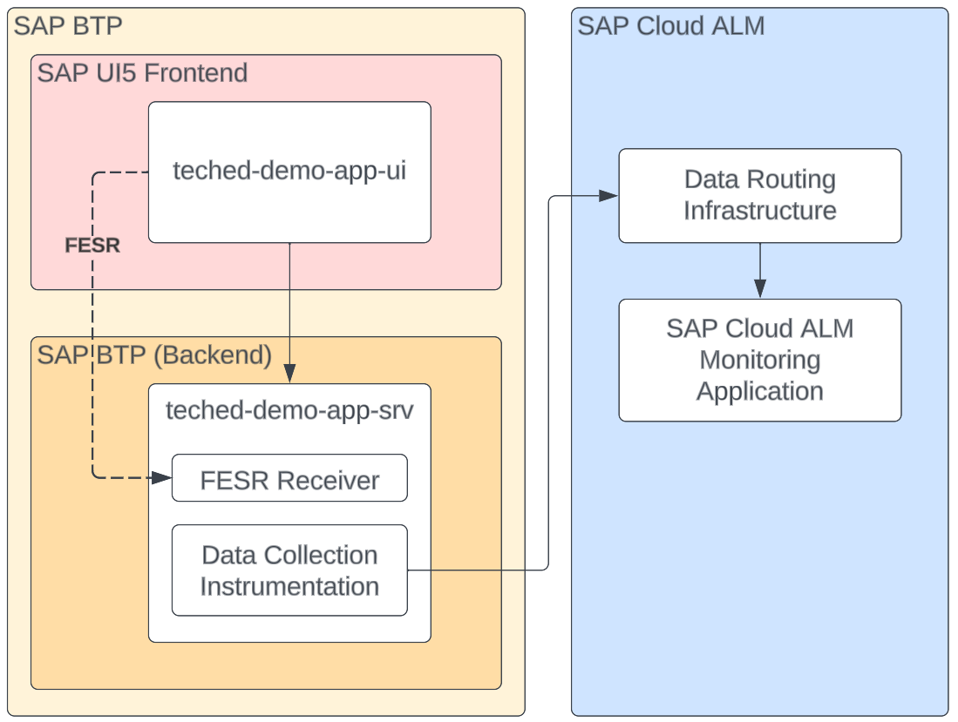
Demo Application

Slide 14
Hands-on Flow
Local Dev Environment
SAP BTP Cockpit
SAP Cloud ALM
Part 1
1 Create destination from custom app to SAP Cloud ALM
4 Activate Monitoring in SAP Cloud ALM
2 Instrument custom app to send metrics to SAP Cloud ALM
3 Deploy instrumented application

Slide 15
Steps: Set up Monitoring with SAP Cloud ALM

Slide 16
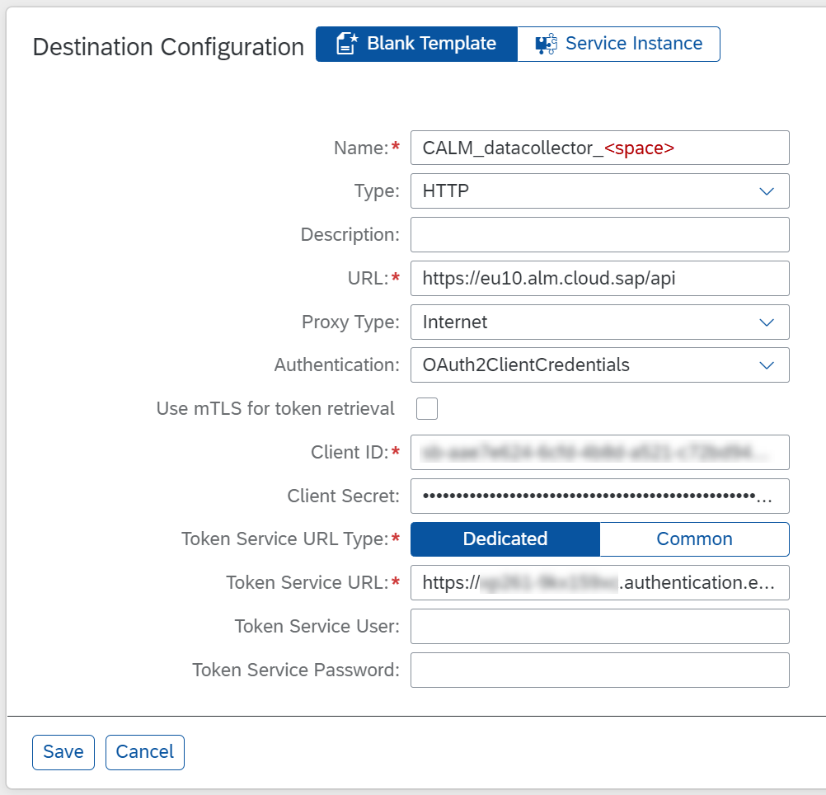
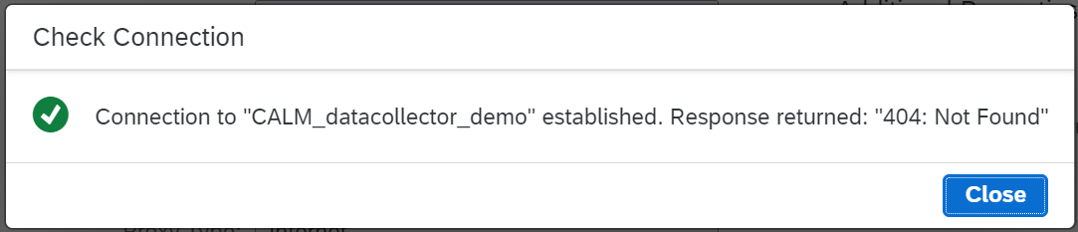
Create Destination in SAP BTP Subaccount
The destination is used to send open telemetry metrics from the SAP BTP subaccount with the custom Java or Node.js application to SAP Cloud ALM
Make sure to enter the name of the Space in which the application is deployed in the destination name
As URL use the API URL from the SAP Cloud ALM service key
As credentials use the credentials in the service key
You can find this key in the SAP BTP subaccount of SAP Cloud ALM or in the SAP Cloud ALM Landscape Management
When you test your destination, the return code 404 is OK

Slide 17
Instrument your Custom Application
The instrumentation necessary depends on the type of the application
You find information for both, Java and Node.js, in the SAP Cloud ALM Expert Portal
https://support.sap.com/en/alm/sap-cloud-alm/operations/expert-portal/data-collection-infrastructure.html
In this demo, we show the instrumentation for a Node.js application

Slide 18
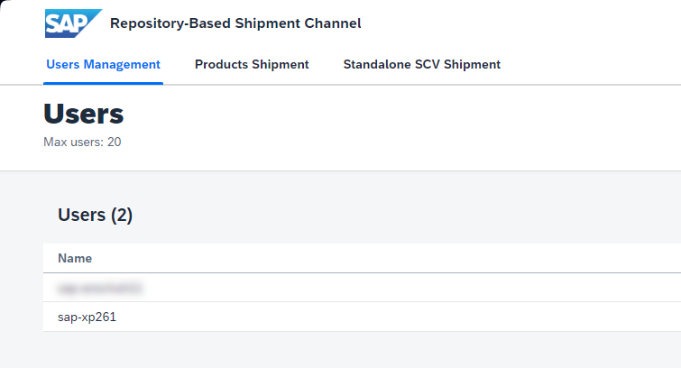
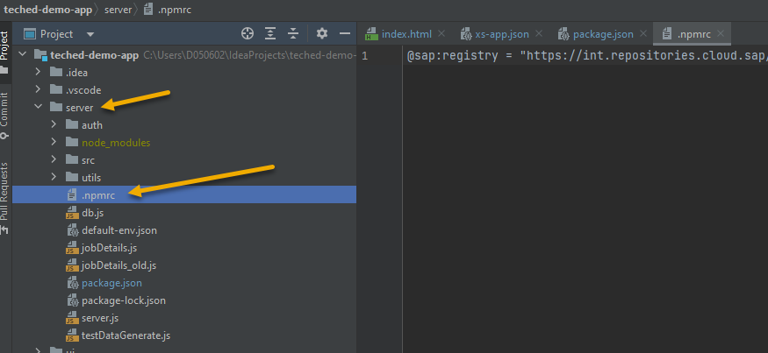
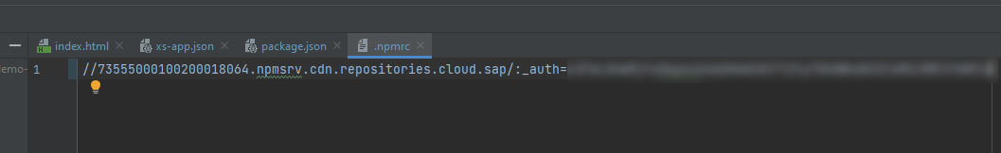
Configure Download Settings
1
The OTEL ALM Libraries are shipped by SAP Repository Based Shipment Channel (RSBC)
As a customer you need to request a technical user name and password in the RBSC UI
Then you need to maintain the credentials in the .npmrc file in your project
2
3

Slide 19
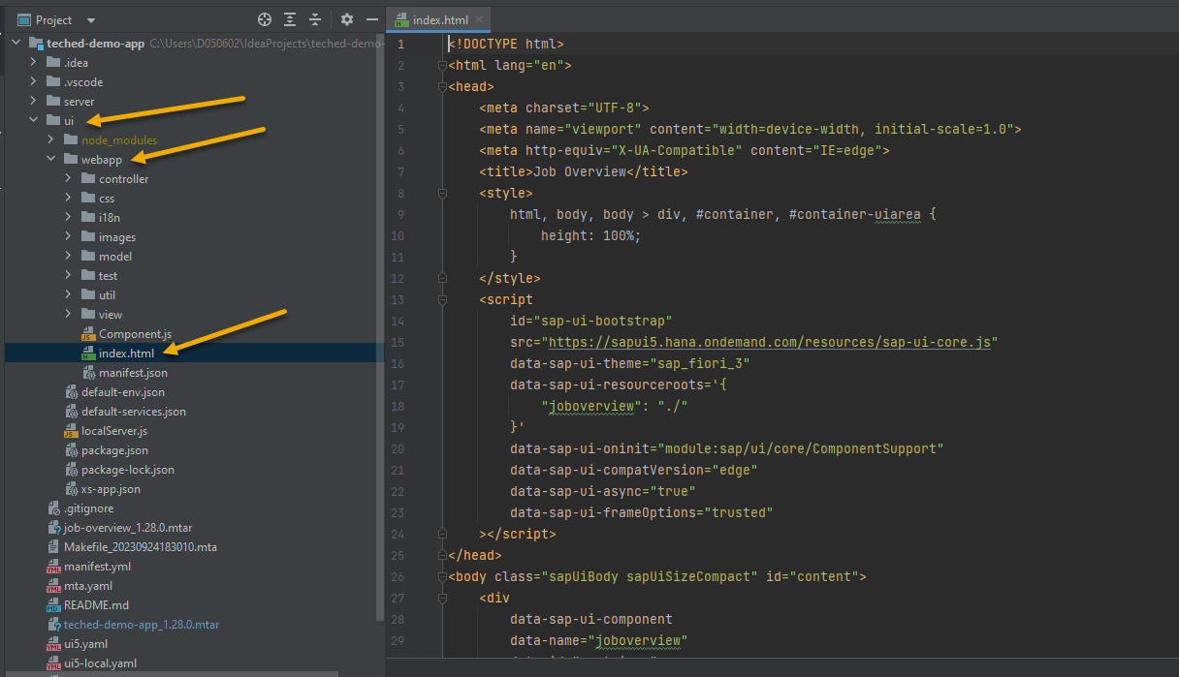
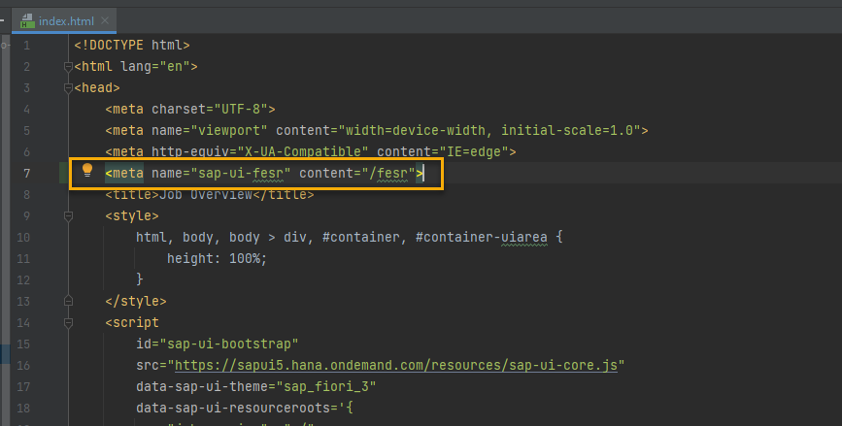
Configure SAP UI5 to send Frontend Statistical Records
For frontend measurements we leverage the Frontend sub records measurement provided by the SAP UI5 framework
The first step is to configure your UI to gather frontend statistics and send them to a receiving endpoint
This can be achieved with a simple meta tag in the root index.html of your UI5 application
You only need to instrument the frontend application if you want to get the end-user response times to be displayed in Real User Monitoring
1
2

Slide 20
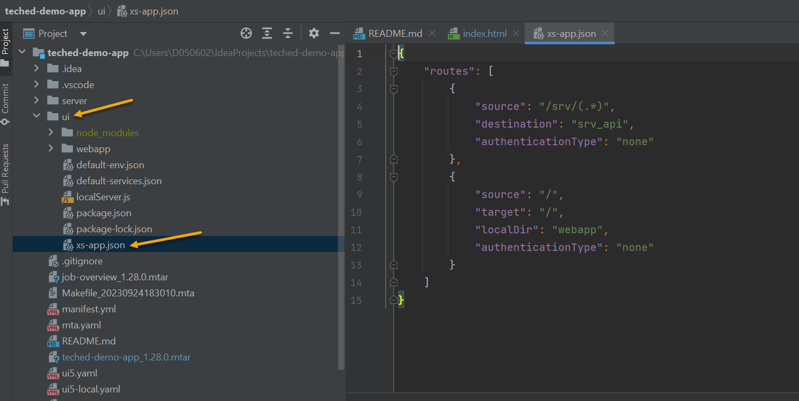
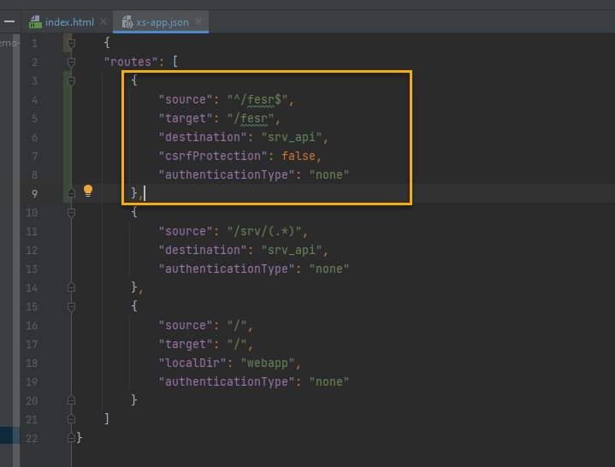
Configure Application Router (Reverse Proxy)
Now you need to configure your reverse proxy (e.g. approuter) to forward the FESR beacons from UI5
To achieve this you need to configure the /fesr route to be routed to the specific endpoint which will be configured in the next step
Do this by adding the route to the xs-app.json file of your ui component
1
2

Slide 21
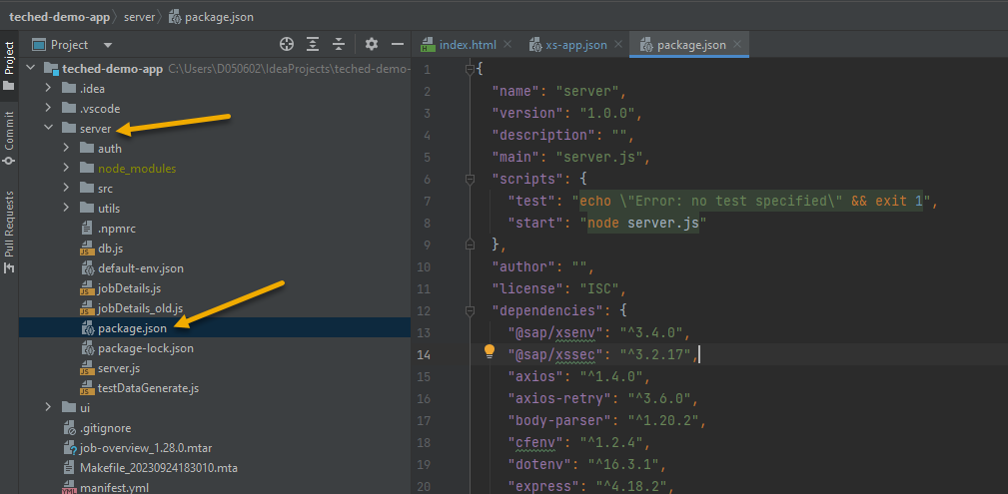
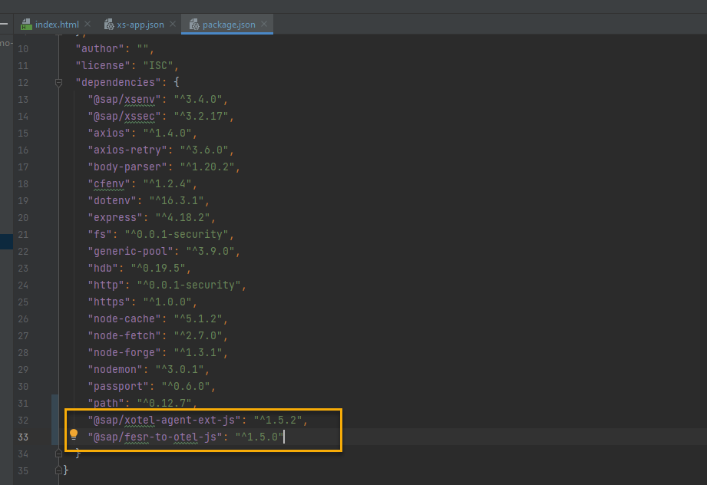
Add Dependencies to Server Application
To receive the FESR and to use the OTEL agents you need to add them as dependencies in the server application
The dependencies are added to the package.json file of your server application
After adding the new dependencies make sure to run an npm install for your servicer application
1
2

Slide 22
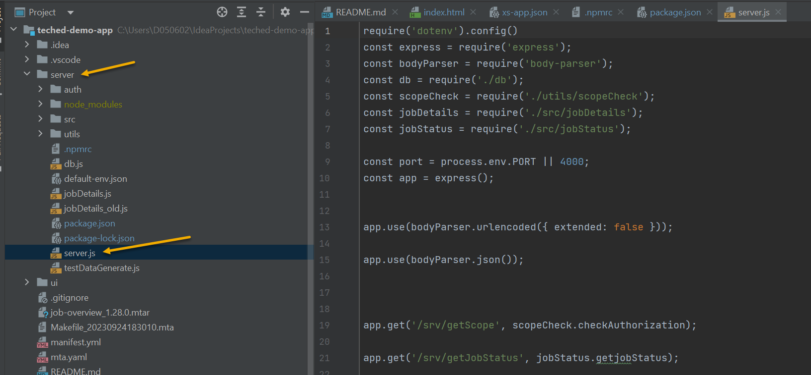
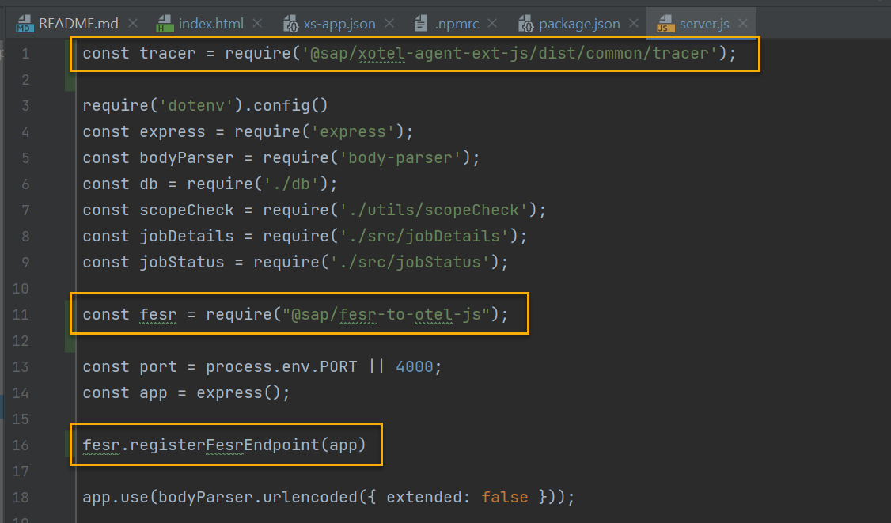
Add a Tracer and the FESR Receiver to the Server Application
To load the instrumentation for the OTEL agents and the FESR receiver, you need to add a tracer and the fesr receiver to the server.js file of your application
1
2

Slide 23
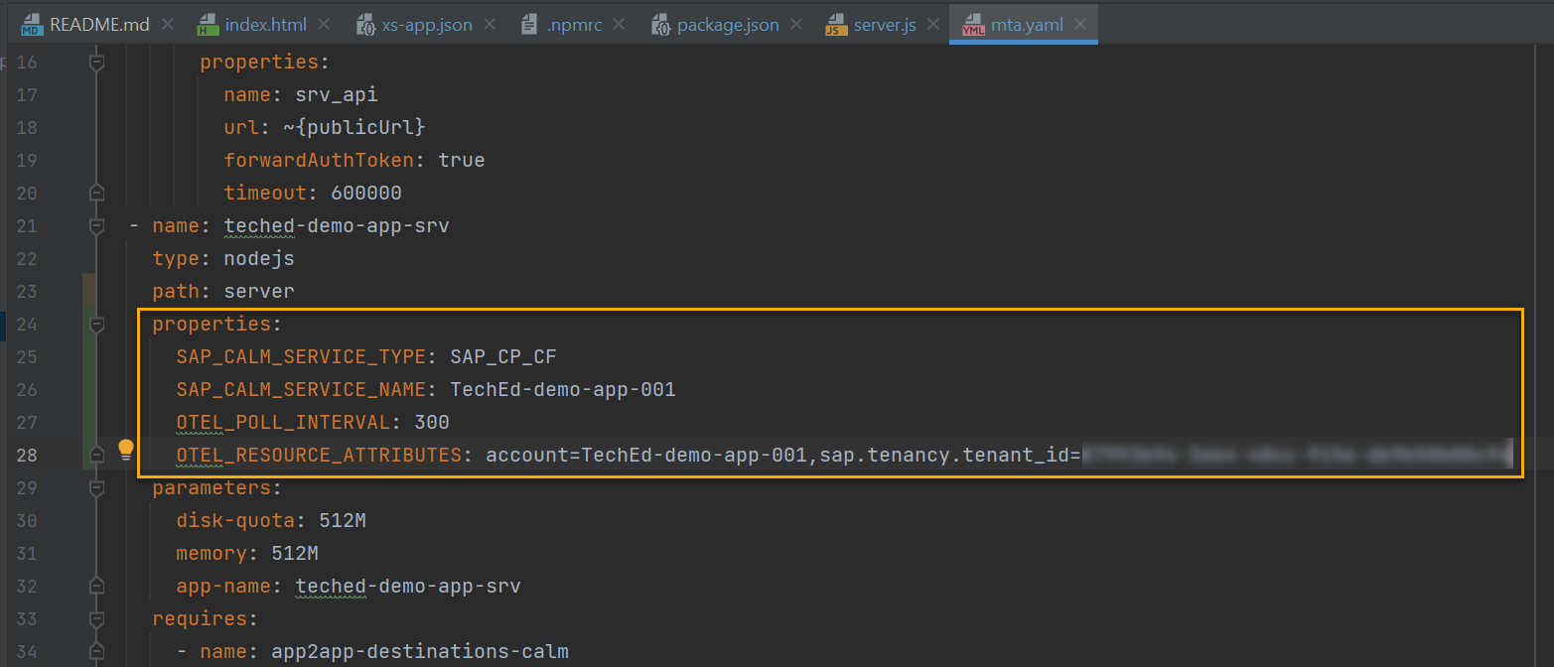
Add Properties to mta.yaml
The last file we need to adjust is the mta.yaml
First we need to add properties to make sure that the instrumentation is loaded correctly
In mta.yaml find the entry for your server application and add the following properties:
SAP_CALM_SERVICE_NAME = <name of your application>
SAP_CALM_SERVICE_TYPE = SAP_CP_CF
OTEL_RESOURCE_ATTRIBUTES = sap.tenancy.tenant_id=<the subaccount id of your custom application>
You find the subaccount ID in SAP BTP Cockpit in the Overview screen of your subaccount

Slide 24
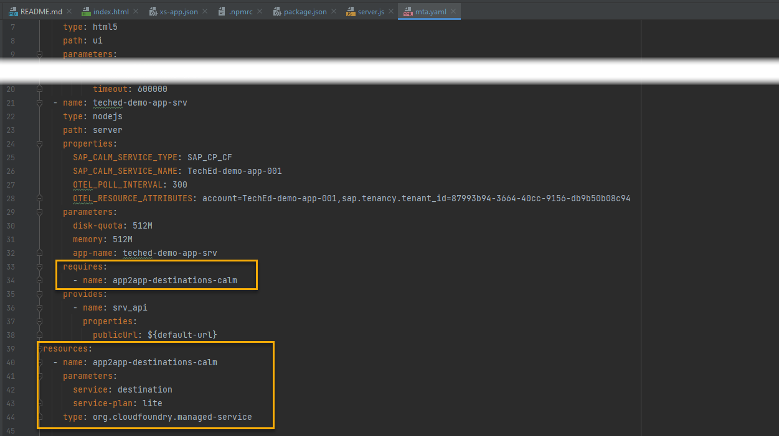
Add destination resource to mta.yaml
To make sure that your application can use the destination you created earlier, you need to add the destination service as a required resource for your application
This is also done in mta.yaml

Slide 25
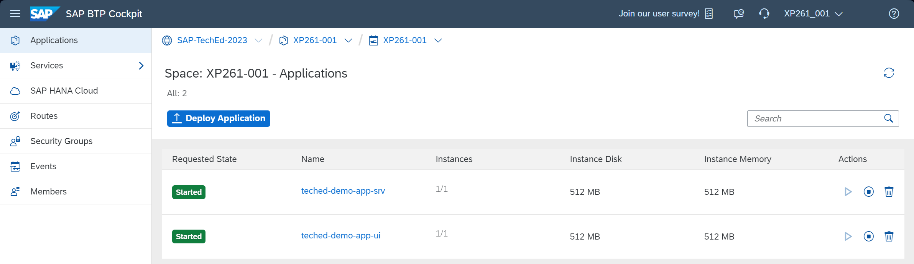
Build and Deploy the Custom Application
After you finished instrumenting your custom application, you can now build and deploy the application again

Slide 26
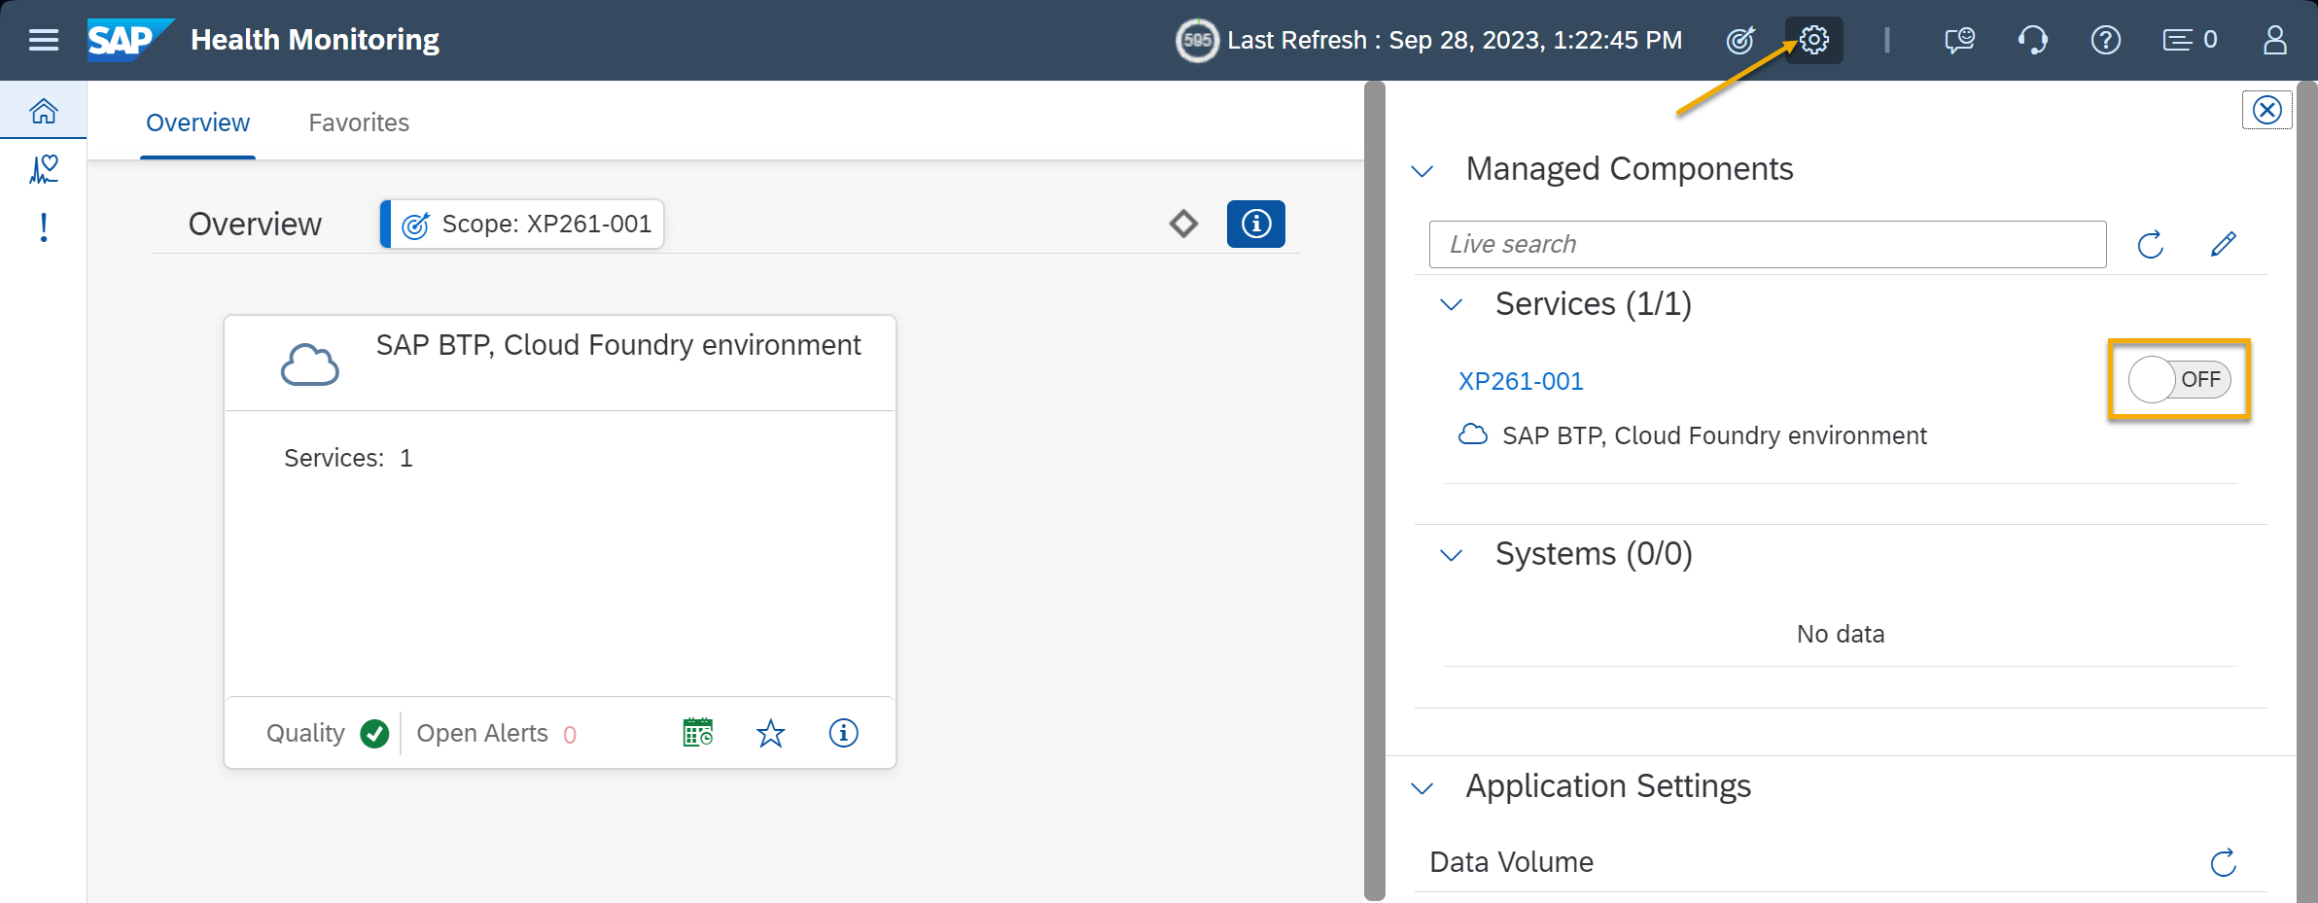
Activate Monitoring in SAP Cloud ALM
Once your instrumented application is deployed and running, it will send data to the Data Routing Infrastructure of our new Next Generation Data Collection Infrastructure (NG-DCI)
The data in collected in the context of the SAP BTP Cloud Foundry environment in which the custom application is running
You can activate the monitoring via the Configuration panel in the SAP Cloud ALM monitoring use case

Slide 27


Make your career growth real
Upskill and engage on SAP Business Technology Platform
Free learning Upskill and prepare for certification
25% discount On SAP Certification exams
Expand your network Engage with experts and share knowledge
GET REAL BENEFITS: learning.sap.com/teched
37%
Of IT certification candidates received salary increases after earning a certification*
92%
Are more confident in their abilities*
*“2023 Value of IT Certification Candidate Report,” Pearson VUE, 2023.
Notes:
Here are some great learning offerings to compliment your conference.
You can prepare for a certification with free SAP Learning Journeys.
Save with an exclusive SAP TechEd certification offer that came in your SAP TechEd registration email
Connect with the experts, expand your network, and share your knowledge and experiences with others in the SAP Community
And network in a moderated SAP Learning Group to get your learning questions answered
Find all the great content at learning.sap.com/teched.

Slide 28
Thank you

